Slide 1
Teeth Segmentation and Labelling in 2D X-ray Images
Yuting Ji, Robert Smithers, Daniella Zunic

Slide 2
Why
Notes:
why are we choosing the project;Our original plans for the project;

Slide 3
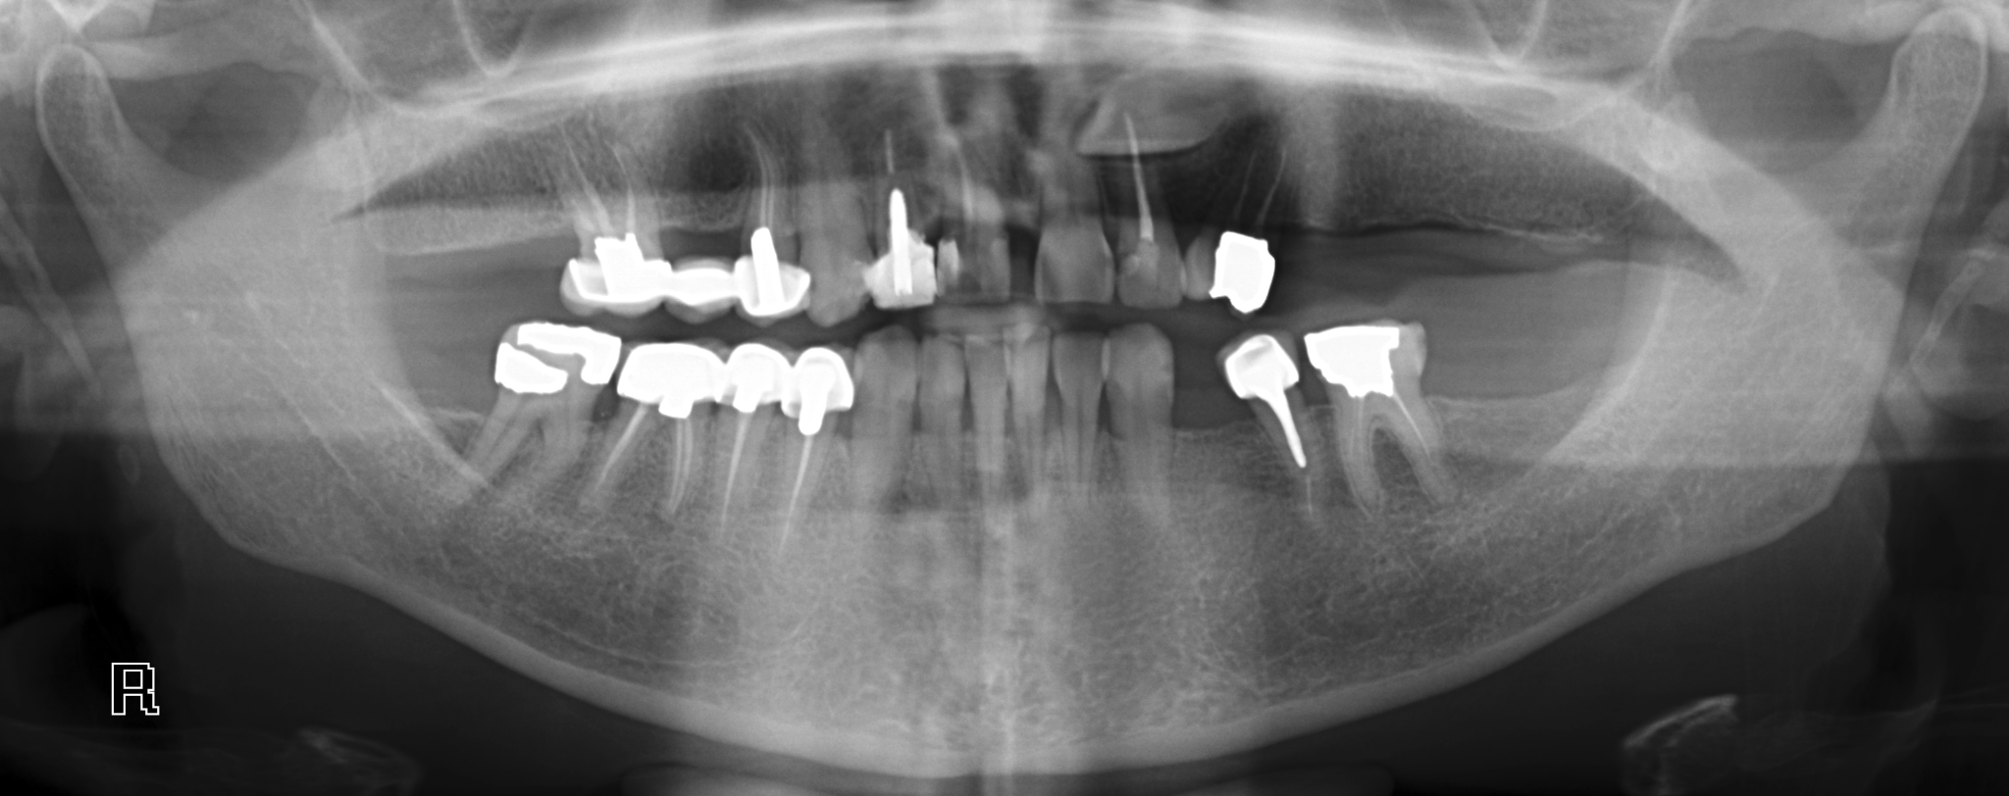
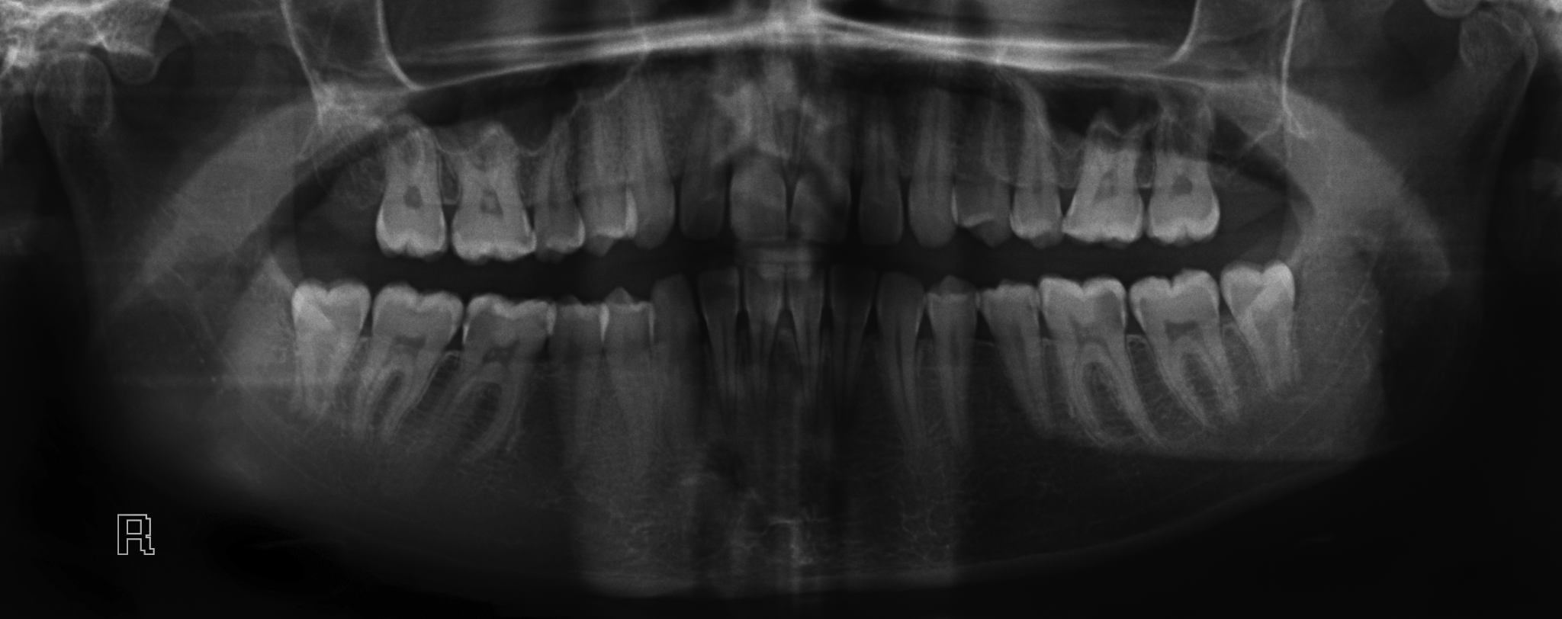
Why X-ray and what are some problems
X-ray images
Grayscale
Overly Bright
Overly Dark
Notes:
Output Result

Slide 4
Expected
Input and Output

Slide 5
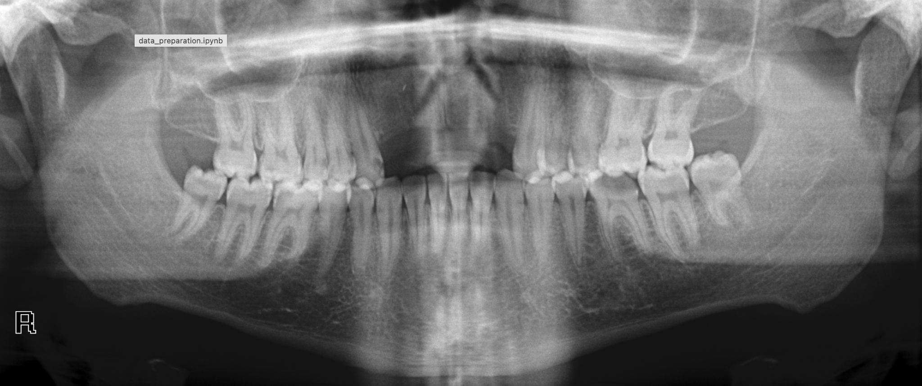
Different Input Images Example

Slide 6
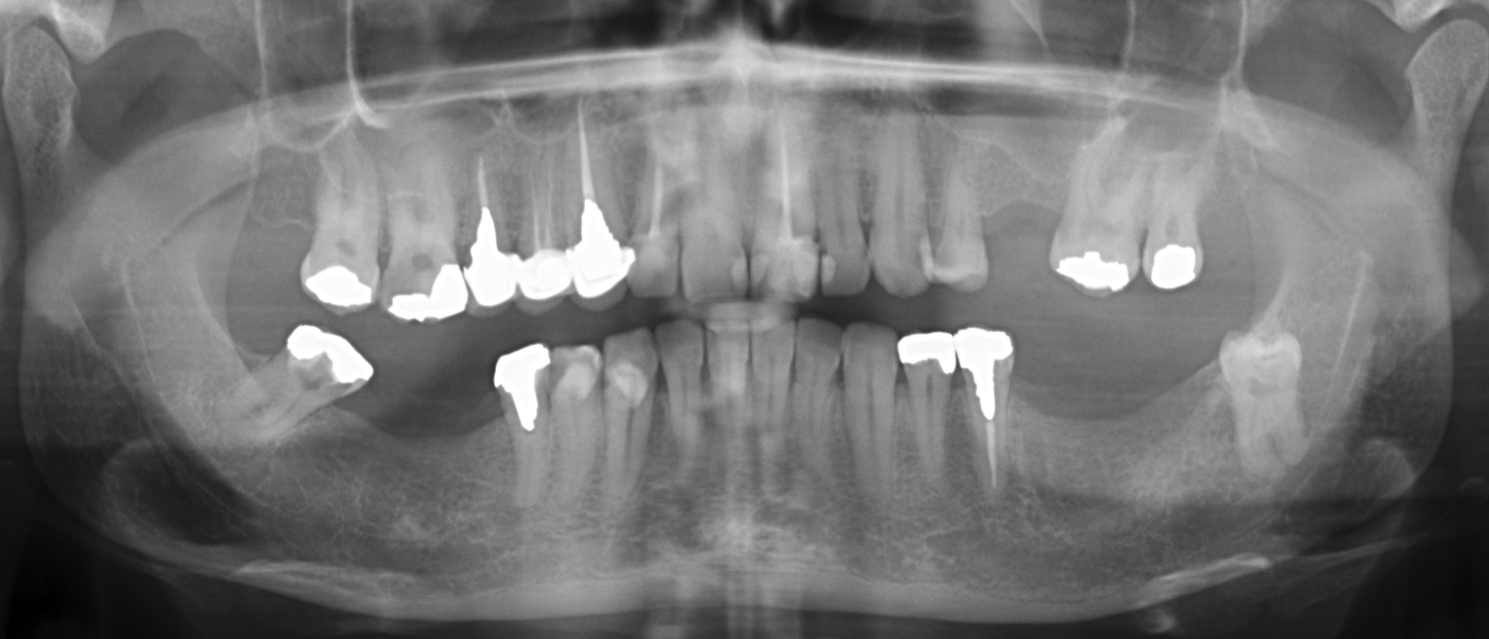
Different Input Images Example

Slide 7
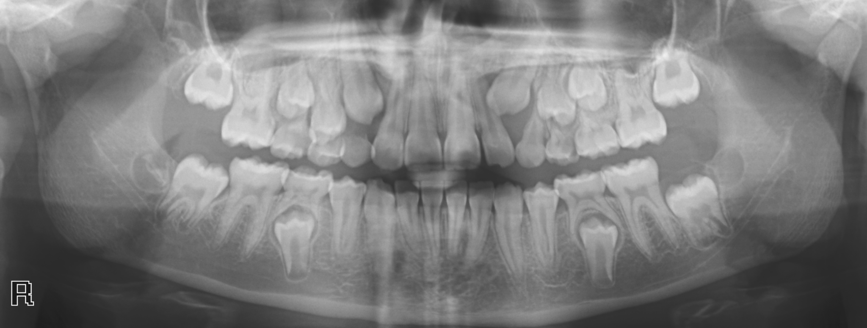

Slide 8
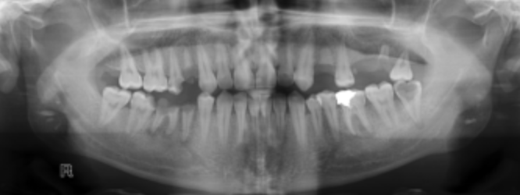
Input Unmasked Image
Notes:
Input Image

Slide 9
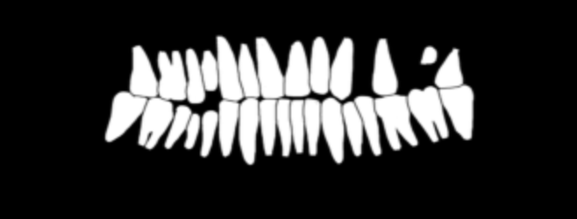
Input Masked Image

Slide 10
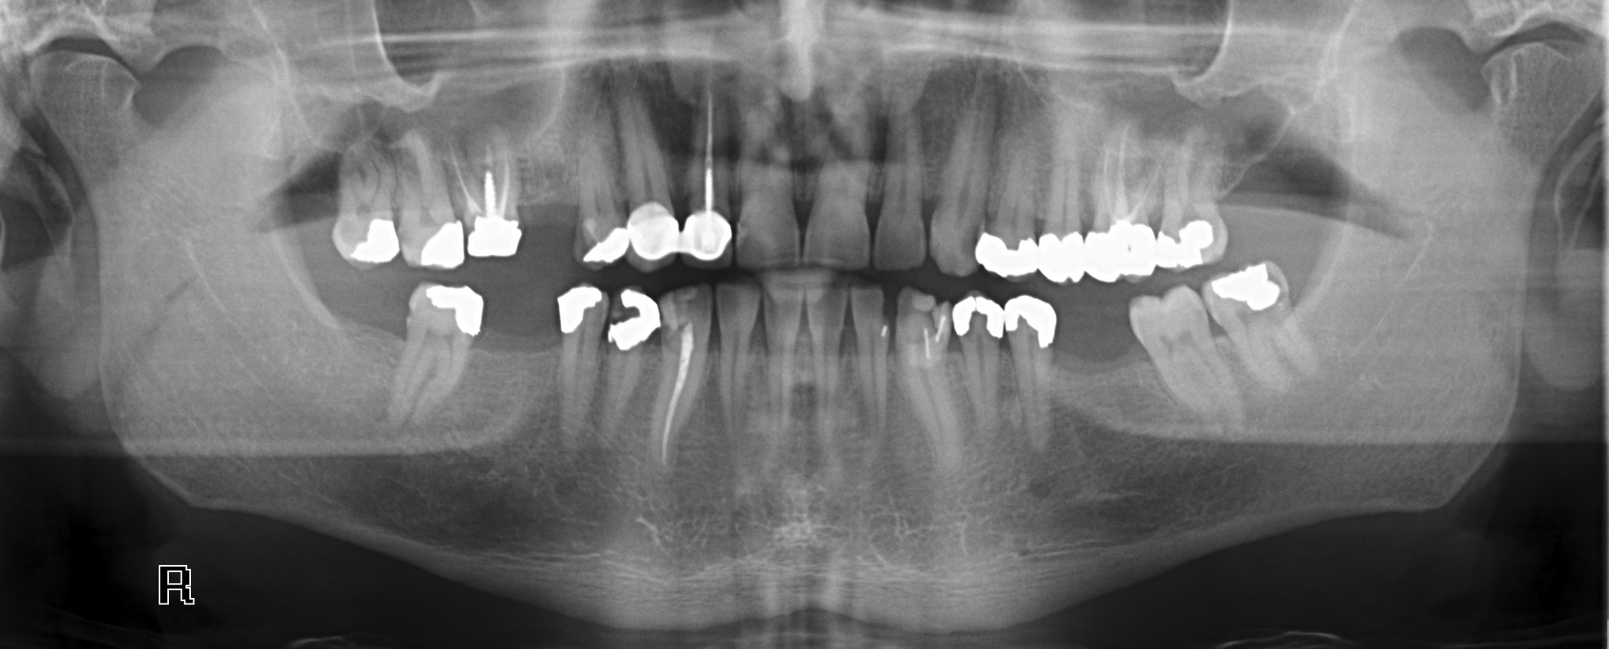
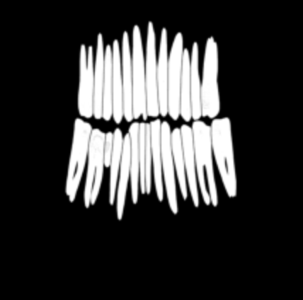
Color
&
Number Labeling
Output Image

Slide 11
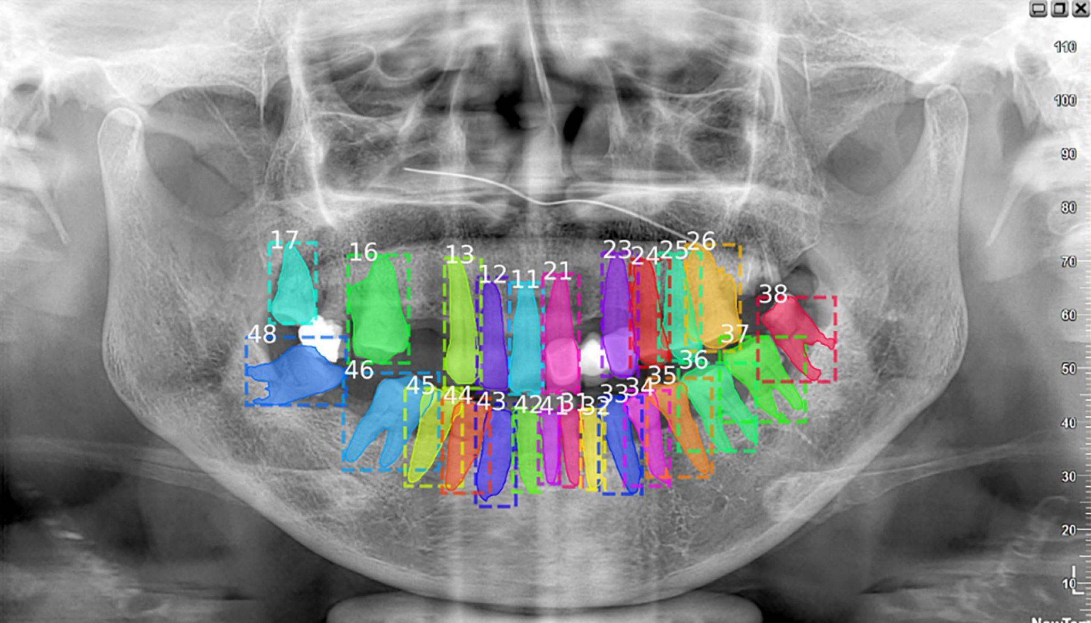

Slide 12
Data Collecting
&
Pre-Process Images
Notes:
Collecting data, introduce the two folders(unmasked and masked); Pre-process Image to 1 channel

Slide 13
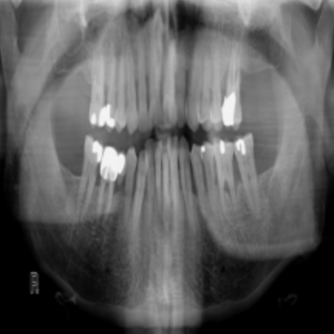
After pre-process, 3104*1200, 1 channel
Notes:
*Click this page to show the masked result during presentation

Slide 14
Dataset
&
DataLoader
Notes:
Yuting’s section

Slide 15
Dataset and Data-Loader
Rename and Merge Files
sklearn
split train and valid
Training data Augmentation
random horizontal flip
random vertical flip
random rotation
normalize
Dictionary to store pairs: ‘image’, ‘annotation’

Slide 16
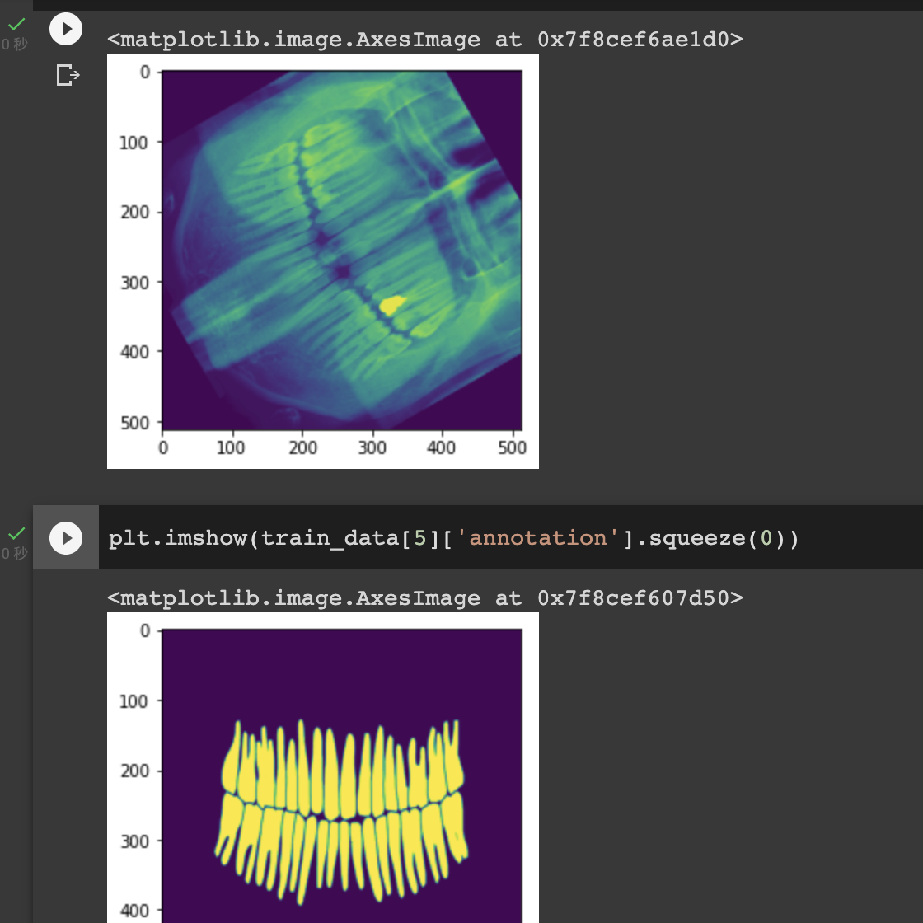
Normalize Images
Feed into three Data-Loaders
Batch-size=2
Shuffle=True

Slide 17
Model Development
&
Training and Testing

Slide 18
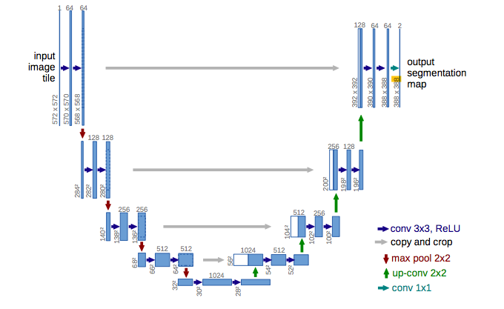
Model
Unet
Previous experience with unet
Double Conv
TConv
Train and test for 150 epoches
Architecture of U-Net based on the paper by Olaf Ronneberger
from Cornell University

Slide 19
Loss
Train vs Test

Slide 20
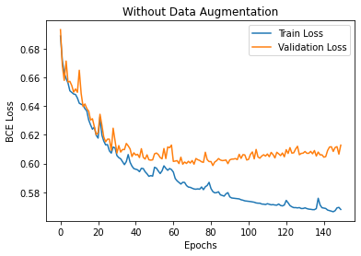
Loss
BCE loss
Train vs Validation Loss
Train vs Test Loss

Slide 21
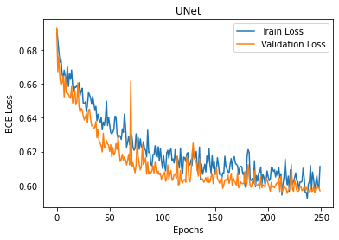
Loss
BCE loss
Train vs Validation Loss
Train vs Test Loss

Slide 22
Possible Improvements

Slide 23

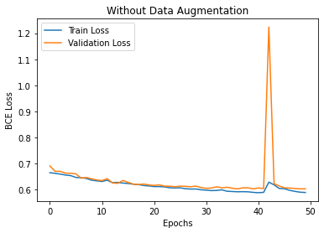
Improvements
Optimization: Model not converging?
ReLU
Weight init
“Average” RGB output
Auto-save checkpoints
Filtering

